Slide 1
COMP-250
Computer Programming II
Instructor: Brandon Dave

Slide 2
Thus far…
What we’ve discussed so far:
Today’s Agenda
Who am I?
Syllabus coverage
Expectations
Our first Java Program

Slide 3
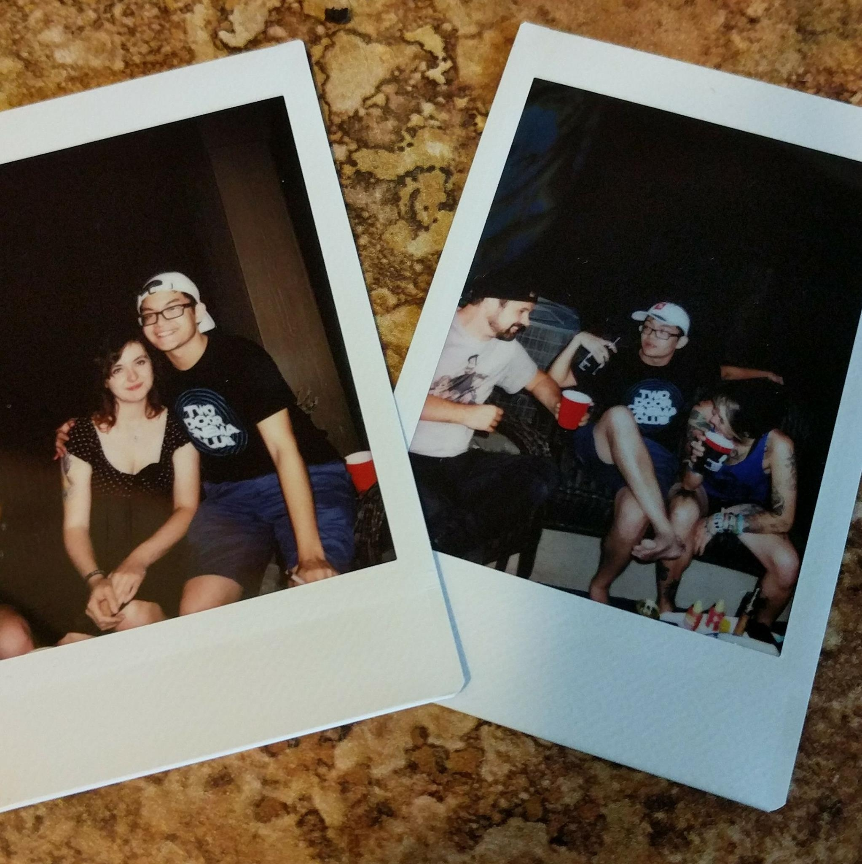
Who am I?
Brandon Dave
BS in IT&CS from Wright State University
MS in CS currently at Wright State University
Focus in Data Science and Machine Learning
Avid World Traveler + Concert Goer
Etc, etc.

Slide 4
Academia: Syllabus
Instructor: Brandon Dave
Contact Information: daveb@wittenberg.edu OR dave.15@wright.edu
Office Hours: MW 12:00PM - 1:55PM
OR BY APPOINTMENT

Slide 5
Academia: Syllabus
As listed in the course description, completion of COMP-250 should consist of the student’s ability to:
Read and Program in Java
Use sound object-oriented programming techniques
Understand standard Java library and documentation
Understand basic data structures as described in the Course Description
The course topics are subject to change, allowing for more time on individual topics. As instructor, I reserve the right to make small adjustments for the best of the class’ needs and requirements.
Program Structure
Standard I/O
Primitive and Numeric Data Types
Program Scope
Control Structures
Documentation
Data Structures
Classes and Objects
Class and Instances Of
Inheritance and Composition

Slide 6
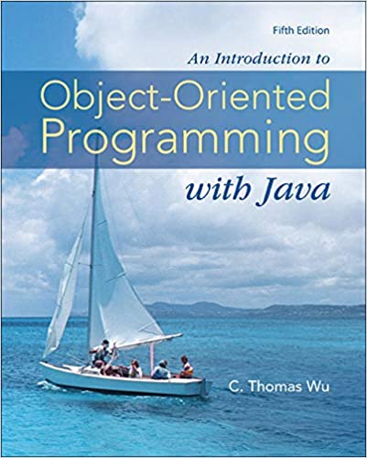
Academia: Syllabus
An Introduction to Object-Oriented Programming with Java, 5th Edition, C. Thomas Wu, McGraw-Hill. 2010. ISBN: 978-0-07-352330-9.
Additional Resources: I reserve the right as instructor to introduce additional resources. Most of these resources can be found online by a query search.
Equally, you are more than welcome to utilize additional resources for your learning. With assignments, you are expected to cite your reference on top of what is demanded of the Header Comment Block

Slide 7
Academia: Syllabus
As written in the syllabus, Attendance is heavily promoted. If you are unable to attend a class due to appointments, illnesses, etc., please refer to the Classroom Attendance Grading section.
Academic Integrity: Academic dishonesty of any kind on programming or written assignments or on an exam is not acceptable. This includes, but is not limited to, copying code in whole or part (even if the code is subsequently altered), plagiarism, and/or unauthorized collaboration with another individual on assignments or tests. The University Honor Code will be followed.
This is further discussed in the Syllabus.

Slide 8
Further Expectations From Me
You are to be held accountable for plagiarism in the form of copying code from each other or online sources.
We might not be an English department, but if you use code you did not formulate yourself (either from the Math Tutor Help Room or outside resources), and are not referencing said help, you are plagiarizing.

Slide 9
Header Comment Block
All programs must start with a Header Comment Block as described in the syllabus
/*
Name:
Semester/Year:
Desc:
I Received Help From:
I affirm that my work upholds the highest standards of honesty and academic integrity at Wittenberg and that I have neither given nor received unauthorized assistance.
*/

Slide 10
Why are you here?
Engineering:
Indifferent about career, so you chose the money route
Someone who really likes the topic, problem solving, theories, or math
You have to take this for your program’s curriculum
College:
Education? Google, Books and Libraries, Online resources
Connections? Yes! The best thing about college are the connections you make. Get to know your classmates, professors, anyone who can give you that extra leg up in progressing into your dream career!
Ask any engineer and they will tell you the same thing: No one is born knowing any of this.
You will make mistakes, but the important thing is to learn from them! Ask questions as often as you need!

Slide 11
Computer Science is Collaborative
You should not feel like you are not allowed to talk to the students around you - but a word of advice to avoid academic integrity breaches, if you’re talking code - laptops closed.
As you come into my office hours, you will discover a notebook or whiteboards come in handy for our field.

Slide 12
Questions, Comments, Concerns?

